Slide 1
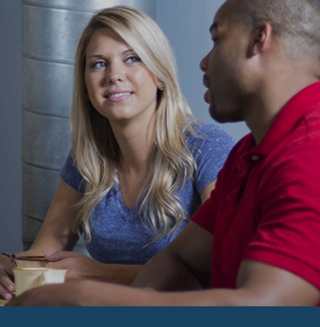
Marketplace 101
Find health care options that meet your needs and fit your budget
March 2016
Notes:
“Marketplace 101” provides a high-level overview of the Affordable Care Act and the Health Insurance Marketplaces, but it focuses on the Federally-facilitated Marketplace, including State-Partnership Marketplaces.
This training presentation was developed and approved by the Centers for Medicare & Medicaid Services (CMS), the federal agency that administers Medicare, Medicaid, the Children’s Health Insurance Program (CHIP), and the Federally-facilitated Health Insurance Marketplaces. The information in this module was correct as of March 2016. To check for an updated version, visit Marketplace.cms.gov.
This as an informational resource for our partners and doesn’t create any rights or impose any obligations. It’s not a legal document or intended for press purposes. Members of the press should contact the CMS Media Relations Group at press@cms.hhs.gov. This is a summary of complex and technical legal standards. Official Medicare and Marketplace program legal guidance is contained in the relevant statutes, regulations, and rulings.

Slide 2
Objectives
This session will help you
Explain the Health Insurance Marketplace
Define who might be eligible
Define options for those with limited income
Explain the enrollment process
Explain available options for people with Medicare
Locate resources
Notes:
This session will help you to:
Explain the Health Insurance Marketplace
Define who might be eligible
Define options for those with limited income
Explain the enrollment process
Explain available options for people with Medicare
Locate resources

Slide 3
What are Health Insurance Marketplaces?
Created by the Affordable Care Act
Where qualified individuals and families can directly compare private health insurance options
Known as qualified health plans (QHPs)
Can directly compare on the basis of price, benefits, quality, and other factors
Also known as Exchanges
Small Business Health Options Program (SHOP)
Marketplace for small employers
Provides coverage for their employees
Notes:
The Health Insurance Marketplace is designed to help find and buy health insurance that fits your budget.
Health insurance plans in the Marketplace offer comprehensive coverage, from doctors to medications to hospital visits. Some plans provide only dental benefits. Marketplace plans that provide medical benefits are called qualified health plans (QHPs). Marketplace plans that cover only dental services are called qualified dental plans (QDPs) or stand-alone dental plans (SADPs). You can compare all your insurance options based on price, benefits, quality, and other features that may be important to you, in plain language that makes sense.
A Marketplace, whether operated by a state or by the federal government, is sometimes referred to as a Health Insurance Exchange .
You’ll know you’re getting a quality health plan at a reasonable price, because the coverage and benefits information and premium rates are readily available.
There’s a Marketplace for small employers too. It’s called the Small Business Health Options Program, or SHOP. We’ll briefly talk about SHOP later. This session focuses on the Individual Marketplace.
This session focuses on the eligibility and enrollment process available through HeathCare.gov (Federally-facilitated Health Insurance Marketplace). If you aren’t in a state that’s using HealthCare.gov please check with your State-based Marketplace for information on the process that applies.

Slide 4
How Health Insurance Marketplaces Work
It uses one process to determine eligibility for
Qualified health plans through the Marketplaces
Premium tax credits to lower monthly premiums
Reduced cost sharing
Medicaid
Children’s Health Insurance Program (CHIP)
It offers choice of plans and levels of coverage
Insurance companies compete for business
Notes:
With one Marketplace application, you can learn if you can get lower costs based on your income, compare your coverage options side-by-side, and enroll. Through this one process, you can find out if you’re eligible for
Qualified health plan (QHP) coverage
Premium tax credits to lower what you pay for your monthly health plan premium
Cost-sharing reductions to lower what you pay out-of-pocket for costs like deductibles, copayments, and coinsurance
Other health coverage programs, like Medicaid (a federal/state program which covers certain people with low income and resources), and the Children’s Health Insurance Program (CHIP) (which covers certain children)
The Marketplaces offer competition and choice. Insurance companies are competing for business on a level and transparent playing field.

Slide 5
Marketplace Establishment
Each state can decide to
Create and run a State-based Marketplace
Have a Marketplace operated by the federal government (Federally-Facilitated Marketplace)
Engage actively with the federal government in operating certain Marketplace functions (State-Partnership Marketplace)
Notes:
Each state has substantial flexibility in ensuring its state has a Marketplace that meets the needs of its citizens. States across the country received grants to support the establishment of Marketplaces in their states. Some states established their own State-based Marketplaces. A state may apply at any time to establish its own State-based Marketplace.
A state may also decide not to establish a State-based Marketplace, but opt for the federal government to operate a Marketplace in its state. In states where the federal government is operating a Marketplace, the state can opt to partner with the federal government. A Partnership Marketplace allows states to make recommendations for key decisions and help tailor a Marketplace to local needs and market conditions. States may also establish and operate only a Small Business Health Options Program (SHOP), while the federal government operates the Individual Marketplace in that state.
U.S. territories can decide whether to establish a Marketplace or expand Medicaid coverage. Residents of a U.S. territory that creates a Marketplace can only enroll in plans in their territory’s Marketplace. They aren’t eligible to apply for health insurance using the Federally-facilitated or a State-based Marketplace; they must be a resident of the state in which a Marketplace is operating to be eligible to enroll in coverage through the Marketplace. Check with your territory’s government offices to learn about these options.

Slide 6
Qualified Health Plans (QHPs)
A QHP
Is offered through the Marketplace by an issuer that is licensed by the state and in good standing
Covers essential health benefits
Is offered by an issuer that offers at least one plan at the “Silver” and one at the “Gold” plan category of actuarial value
Charges same premium whether offered through a Marketplace or outside a Marketplace
Notes:
A qualified health plan (QHP) is an insurance plan that is certified by the Marketplaces, provides essential health benefits, follows established limits on cost-sharing (like deductibles, copayments, and out-of-pocket maximum amounts), and meets other requirements. A QHP must be certified by each Marketplace in which it is sold.
Additionally, a QHP must be offered by a health insurance issuer that
Is licensed and in good standing to offer health insurance coverage in each state in which the issuer offers health insurance coverage
Agrees to offer at least one QHP at the Silver level and at least one plan at the Gold level in a Marketplace
Agrees to charge the same premium rate for each QHP without regard to whether the plan is offered through a Marketplace or whether the plan is offered directly from the issuer or through an agent
Agrees to offer a zero cost sharing or limited cost sharing variation to American Indians and Alaska Natives in any plan category
Complies with the regulations developed by the Secretary under Section 1311(e) and such other requirements as an applicable Marketplace may establish

Slide 7
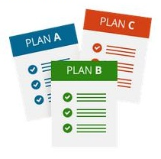
Qualified Health Plans Cover Essential Health Benefits
Essential health benefits include at least these 10 categories
Ambulatory patient services
Emergency services
Hospitalization
Maternity and newborn care
Mental health and substance use disorder services, including behavioral health treatment
Prescription drugs
Rehabilitative and habilitative services and devices
Laboratory services
Preventive and wellness services and chronic disease management
Pediatric services, including oral and vision care (pediatric oral services may be provided by stand-alone plan)
Notes:
The Affordable Care Act provides for the establishment of an Essential Health Benefit (EHB) package that generally includes coverage of EHBs (as defined by the Secretary of the Department of Health and Human Services [the Secretary]). The law directs that EHBs be equal in scope to the benefits covered by a typical employer plan and cover at least the following 10 general categories:
Ambulatory patient services (outpatient care you get without being admitted to a hospital)
Emergency services
Hospitalization (such as surgery)
Maternity and newborn care (care before and after your baby is born)
Mental health and substance use disorder services, including behavioral health treatment (this includes counseling and psychotherapy)
Prescription drugs
Rehabilitative and habilitative services and devices (services and devices to help people with injuries, disabilities, or chronic conditions gain or recover mental and physical skills)
Laboratory services
Preventive and wellness services and chronic disease management
Pediatric services, including oral and vision care (pediatric oral services may be provided by stand-alone plan)
NOTE: Marketplaces only offer Qualified Health Plans, including stand-alone dental QHPs that cover pediatric dental essential health benefits. Each state has a benchmark plan that’s the basis for what services a QHP must cover as essential health benefits. If a state’s base-benchmark plan lacks pediatric dental or vision coverage it must be supplemented with the Federal Employee Dental and Vision Insurance Program’s (FEDVIP’s) pediatric vision/dental plan; or the state’s separate CHIP plan benefit if one exists. Pediatric services must be covered for individuals under 19, but states have the flexibility to extend pediatric coverage beyond 19.

Slide 8
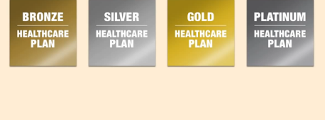
Health Plan Categories
Lowest Premiums
Highest Out-of-Pocket Costs
Highest Premiums
Lowest Out-of-Pocket Costs
60% | 70% | 80% | 90%
Average Percentage of Covered Care Paid By the Plan
Notes:
Plans in the Marketplaces are primarily separated into 4 health plan categories—Bronze, Silver, Gold, and Platinum—based on the percentage the plan pays of the average overall cost of providing essential health benefits (EHBs) to members. The plan category you choose affects the total amount you'll likely spend for EHBs during the year.
Each plan category is associated with an actuarial value (AV), which, when looking across an entire population, can be considered a general summary measure of what portion of health costs the health plan will pay. AV represents the percentage of the total allowed costs of benefits paid by the plan, based on the provision of EHBs. For example, if a plan has an AV of 70%, on average, you would be responsible for 30% of the costs of all covered benefits.
The health plan categories are as follows:
Bronze level—a health plan that has an AV of 60%
Silver level—a health plan that has an AV of 70%
Gold level—a health plan that has an AV of 80%
Platinum level—a health plan that has an AV of 90%
However, you could be responsible for a higher or lower percentage of the total costs of covered services for the year, depending on your actual health care needs and the terms of your insurance policy. While premiums aren’t taken into account to calculate the AV, generally plans with a higher AV and more generous cost sharing tend to have higher premiums.

Slide 9
Catastrophic Health Plans
What is catastrophic coverage?
Plans with high deductibles and lower premiums
You pay all medical costs for covered care up to the annual limit or cost sharing for the plan year
Includes 3 primary care visits per year and certain recommended preventive services with no out-of-pocket costs
Protects you from high out-of-pocket costs
Who is eligible?
Young adults under 30 at the time they enroll or those who qualify for a hardship exemption
Notes:
Catastrophic Plans are health plans that meet all of the requirements applicable to other Qualified Health Plans (QHPs) but that don't cover any benefits other than 3 primary care visits per year before the plan's deductible is met. The premium amount you pay each month for health care is generally lower than for other QHPs, but the out-of-pocket costs for deductibles, copayments, and coinsurance are generally higher. To qualify for a catastrophic plan, you must be under 30 years old OR get a "hardship exemption" because the Marketplace determined that you’re unable to afford health coverage. Each member of a family must meet the eligibility requirements to purchase a catastrophic plan.
NOTE: People who enroll in catastrophic health plans aren’t eligible for premium tax credits to lower their monthly premiums. Regardless of your income, you pay the standard price for the catastrophic plan.

Slide 10
Eligibility and Enrollment in the Individual Market
To be eligible for Marketplace coverage, you must
Be a resident of a state served by the Marketplace, and
Be a U.S. citizen, U.S. national, or a non-citizen who’s lawfully present in the U.S. (and expected to be for the entire time coverage is sought), and
Not be incarcerated (other than incarceration pending disposition of charges)
Notes:
To be eligible for Marketplace coverage, you must:
Be a resident of a state served by the Marketplace.
Be a citizen or national of the United States (U.S.), or a non-citizen who is lawfully present in the U.S.
Not be incarcerated, other than incarceration pending the disposition of charges.
Eligibility information on the application is verified through electronic data checks with the IRS, SSA, the Department of Homeland Security, and other electronic data sources approved for eligibility verification.
If you meet the eligibility requirements to purchase a Qualified Health Plan through the Marketplace, you’re considered a “qualified individual.” If you don’t meet the citizenship, status as a national, or lawful presence requirement you can’t be a qualified individual. There’s no waiting period, such as in Medicaid, that provides eligibility after you have lived in the U.S. for a set period of time.
If you have a student visa you may be eligible for coverage through the Marketplace, but not for Medicaid or CHIP.
NOTE: Qualified individuals living abroad who aren’t physically present in the United States for at least 330 full days in a 12-month period may be eligible for an exemption so they won’t have to pay the fee.

Slide 11
Lower Premium Costs
The premium tax credit may be taken as advance payments (APTC) paid directly to issuers to lower monthly premium costs, or as a refundable credit on the tax return you file
Eligibility for APTC is based on
Household income and family size
Household income between 100% to 400% FPL
$24,250 – $97,00 for a family of 4 in 2016 (higher in Alaska and Hawaii)
Not being eligible for other minimum essential coverage, and including most government-sponsored coverage, affordable employer-sponsored insurance that meets certain minimum standards, or certain other minimum essential coverage
Notes:
When you use a Marketplace, you may be eligible to receive advance premium tax credits paid directly to the issuers, that may be used to lower your monthly premiums, and cost-sharing reductions that lower your out-of-pocket costs. The premium tax credit is generally available to individuals and families with household incomes between 100% and 400% of the federal poverty level, $24,250 – $97,000 for a family of 4 in 2016 (higher in Alaska and Hawaii), who don’t have access to certain other types of minimum essential coverage. This makes coverage much more affordable for the middle class.
Remember, minimum essential coverage includes government-sponsored coverage (like Medicare, Medicaid, CHIP, some VA coverage, and TRICARE), affordable employer-sponsored insurance (meaning the cost for the employed individual is no more than 9.66% of their income), and certain other coverage.

Slide 12
Ways to Use a Premium Tax Credit
Choose to Get It Now: Advance Payments of the Premium Tax Credit (APTC)
All or some of the APTC is paid directly to your plan on a monthly basis You pay the difference between the monthly premium and APTC You reconcile the APTC when you file a tax return for the coverage year*
Choose to Get It Later
Don’t request any advance payments You pay the entire monthly plan premium Claim the full amount on the tax return filed for the coverage year
You should report all changes in the information you provided on your application to avoid owing money, if you got more PTC then you were eligible for, after reconciliation on your tax return. Or, you could get money back or credited against any tax you may owe if you didn’t get all the PTC for which you were eligible.
Notes:
If you enroll through an individual Marketplace you may be eligible to receive premium tax credits which can be used to reduce the cost of monthly premiums for yourself and for any tax dependents. You can choose to receive a portion of the credit each month as an advance payment of the premium tax credit—with reconciliation at the end of the year—or to receive the tax credit on your federal tax return filed for the coverage year. Advance payments are paid directly to qualified health plan issuers on a monthly basis.
Individuals eligible for a premium tax credit who don’t receive an advance payment of the premium tax credit may claim the credit on their income tax return filed for the coverage year. Individuals who are married at the end of the coverage year are required to file a joint return to receive a premium tax credit.
A tax filer on whose behalf advance payments are made is required to file a tax return for the coverage year to reconcile any advance payments of the premium tax credit with the premium tax credit allowed on the return. Thus, if the premium tax credit allowed on the return is more than the amount of the advance payment of the premium tax credit, the individual may receive the excess amount as a tax credit. On the other hand, if the amount of the premium tax credit determined based on annual household income and family size on the tax return is less than the amount of the advance payment of the premium tax credit, the individual will be responsible for repayment of the excess amount via the tax return, subject to statutory caps.
The Marketplace will provide documentation to the tax filer and to the IRS that will support the reconciliation process, in the same way that an employer or bank provides a Form W-2 or Form 1099. You should report all changes to the information in your application (such as marriage, divorce, birth, eligibility for affordable employer coverage, and increases and decreases in household income), as soon as possible to avoid owing money after reconciliation on your tax return.

Slide 13
Who’s Eligible for Cost-Sharing Reductions?
Lower out-of-pocket costs on deductibles, copayments, and coinsurance
To be eligible, you must
Have income at or below 250% FPL
$60,625 annually for a family of 4 in 2016 (higher in Alaska and Hawaii)
Be eligible for advance payments of the premium tax credit
Enroll in a Marketplace Silver-level plan, unless they’re members of a Federally-recognized tribe
Members of federally recognized Indian tribes
Don’t have to pay cost-sharing if household income is at or below 300% of the federal poverty level (FPL), and they’re eligible for advance payment of the premium tax credit
Up to around $72,750 for a family of 4 ($90,960 in Alaska) in 2016
Don’t have to enroll in a Silver-level plan
Notes:
Cost sharing means any expenditure required by or on behalf of an enrollee with respect to essential health benefits (EHB), including deductibles, coinsurance, copayments, or similar charges. Cost sharing excludes premiums, balance billing amounts for non-network providers, and spending for non-covered services. Cost-sharing reductions are available to help reduce your out-of-pocket expenses, including deductibles, copayments, and coinsurance.
To be eligible for a cost-sharing reduction, you must have a household income that is less than or equal to 250% of the federal poverty level (FPL) which is $60,625 annually for a family of 4 in 2016); meet the requirements to enroll in a qualified health plan through the Marketplace; receive the premium tax credit; and enroll in a Silver-level plan through the Marketplace.
There are 3 levels of cost-sharing reductions:
If your income is between 100% and 150% FPL ($24,250-$36,375* for a family of 4 in 2016, the actuarial value (AV) of your Silver-level plan is approximately 94% (you pay 6% for covered services).
If your income is between 150% and 200% FPL ($36,375-$48,500* for a family of 4 in 2016), the AV of your Silver-level plan is approximately 87% (you pay 13% for covered services).
If your income is between 200% and 250% FPL ($48,500-$60,625* for a family of 4 in 2016), the AV of your Silver-level plan is approximately 73% (you pay 27% for covered services).
Members of federally recognized tribes, shareholders of Alaska Native regional and village corporations, California Indians, and persons of Indian descent who are eligible for services from the Indian Health Service, tribal programs, or urban Indian health programs, who purchase health insurance through the Marketplace (regardless of plan category like Bronze or Silver) don’t pay premiums and cost-sharing if their income is under 300% FPL, which is roughly $72,750 for a family of 4 in 2016 ($90,960 in Alaska and $83, 670 in Hawaii)
*Higher in Hawaii and Alaska.

Slide 14
Medicaid Eligibility
Eligibility tied to groups specified under the federal Medicaid law
Pregnant women
Children
People with disabilities
Seniors
Parents and caretaker relatives
States must cover certain groups, such as children and pregnant women, and have the option to cover other groups, such as childless adults
Financial and non-financial requirements
Notes:
To qualify for Medicaid, you must belong to one of the eligibility groups specified under the federal Medicaid law. To be eligible for federal funds, states must cover people in certain groups up to federally defined income thresholds. However, many states have expanded Medicaid beyond these thresholds and have extended coverage to other optional groups. There are financial and non-financial requirements that must be met. Non-financial requirements include residency and citizenship requirements.
Because of the Affordable Care Act, more states now have options to cover additional groups, which we’ll discuss next.

Slide 15
Eligibility—Medicaid Expansion
Affordable Care Act’s Eligibility Groups
Adult group
19-64 with income below 133% of FPL
Former foster care group
Under 26 and enrolled in Medicaid while in foster care at 18 or “aged out” of foster care (no income test)
Optional eligibility group for individuals with income above 133% of FPL
Under 65 with income above 133% of FPL
12-month eligibility period for most adults, parents, and children
Notes:
The Affordable Care Act established 3 new Medicaid eligibility groups that made health insurance available to millions of people who weren’t previously eligible.
The New Adult Group covers certain individuals 19-64 with income below 133% of the FPL, including 19- and 20-year-old children. Children under 19 aren’t included in this group because they’re covered under other mandatory eligibility groups. To be eligible for the New Adult Group, individuals may not be entitled to or enrolled in Medicare, they can’t be eligible for any other mandatory Medicaid eligibility group, and they may not be pregnant at the time of enrollment. This group is a mandatory eligibility group that states can elect to cover. To date, 31 states and the District of Columbia have expanded their programs to cover this group.
A second eligibility group created under the Affordable Care Act generally established Medicaid coverage for individuals under 26 who were enrolled in Medicaid while they were either in foster care at 18 or when they “aged out” of foster care. There is no income or resource test for this eligibility group.
The third group is similar to the New Adult Group. Individuals in this group must be under 65, with income above 133% of the FPL, and can’t otherwise be eligible for another Medicaid group. Unlike the eligibility requirements for the New Adult Group, individuals in this optional group may be pregnant or may be eligible for Medicare. In addition, this group covers both children and adults who aren’t otherwise eligible for Medicaid..
In states expanding Medicaid, individuals will probably qualify if they make up to about $16,100 a year for one person ($32,900 for a family 4).
There is a 12-month eligibility period for most adults, parents, and children.
NOTE: The Medicaid expansion up to 133% of the FPL resulted in a number of states needing to transition children 6-18 between 100-133% of the FPL that were previously covered in separate Children’s Health Insurance Programs to Medicaid.

Slide 16
Application and Eligibility
Premium tax credit
Cost-sharing reduction
Enroll in
Marketplace
qualified health plan
Submit streamlined application to a Marketplace
Verify and determine eligibility
Eligible for qualified health plan
YES
Pay first monthly premium
Eligible for Medicaid, or CHIP
Online
By phone
By mail
In person
Supported by Data Services Hub
YES
Enroll
Medicaid/CHIP
Notes:
The first step in the application and eligibility process is to submit a streamlined application to a Marketplace. You can apply online, by phone, by mail, or in person.
When you complete the application, your information will be verified including: residency; that you live in the service area of that Marketplace; your incarceration status; American-Indian/Alaska Native status; household income; household size; and eligibility for other essential coverage including employer coverage or government programs like Medicare, Medicaid, CHIP, VA, and TRICARE. This information is checked electronically against the data of Social Security, the Internal Revenue Service, Department of Defense, Department of Homeland Security, and other approved electronic data sources for verification. Anyone who submits an incomplete application through HealthCare.gov will receive a notice and have 90 days to provide the needed information. State Marketplaces could have fewer days.
You may be determined eligible to purchase and enroll in a qualified health plan through a Marketplace, or enroll in Medicaid or the Children’s Health Insurance Program (CHIP). If you’re eligible to enroll in a qualified health plan in a Marketplace, you also find out if you’re eligible for a premium tax credit and cost-sharing reduction.
Then, you enroll in the program for which you’re eligible. If you’re eligible for Medicaid or CHIP, and also qualify for a QHP, you can join a QHP without financial assistance.
NOTE: If you don’t have a street address for your home, indicate “no fixed address” and you’ll be able to include a mailing address such as a P.O. Box number.

Slide 17



Everyone Must:
Have minimum essential coverage They’re already covered and don’t need to do anything. | Have an exemption from the shared responsibility payment (fee) They don’t have to get coverage and won’t have to pay a fee for not having coverage. | Pay a fee (shared responsibility payment) They should consider getting coverage. If they don’t, they’ll pay a fee.
OR
OR
Notes:
The Affordable Care Act requires all applicable individuals to obtain minimum essential coverage or pay a fee (shared responsibility payment).
Everyone must have minimum essential coverage, have an exemption from the shared responsibility payment (fee), or pay a fee.
If you have minimum essential coverage, you don’t have to do anything. You’re already covered. If you qualify for an exemption for a month, you won’t have to pay the fee even if you don’t have coverage. But, if you don’t have coverage and don’t qualify for an exemption, you have to pay a fee. Let’s look at what all this means.

Slide 18
1. What is Minimum Essential Coverage?
If you have coverage from any of the following, you’re covered and don’t have to do anything
Employer-sponsored coverage, including COBRA and retiree
Individual coverage (outside the Marketplace)
Marketplace coverage
Medicare (Part A) and Medicare Advantage Plans
Most Medicaid coverage
Children’s Health Insurance Program (CHIP)
Certain veteran’s health coverage (from the VA)
Notes:
The following provides minimum essential coverage. If you have it you don’t have to do anything.
Employer-sponsored coverage, including self-insured plans, COBRA coverage and retiree coverage
Coverage purchased in the individual market, including a qualified health plan offered by the Health Insurance Marketplace
Medicare (Part A) coverage and Medicare Advantage Plans
Most Medicaid coverage
Children’s Health Insurance Program (CHIP) coverage
Certain types of veteran’s health coverage administered by the Department of Veterans Affairs

Slide 19
What is Minimum Essential Coverage? Continued
If you have coverage from any of the following, you have minimum essential coverage
Most types of TRICARE coverage
Coverage provided to Peace Corp volunteers
Coverage under the Nonappropriated Fund Health Benefit Program
Refugee Medical Assistance (ACF)
Self-funded health coverage offered to students by universities
State high risk pools
Other coverage recognized by the Secretary of HHS
Notes:
The following provide minimum essential coverage. If you have it you don’t have to do anything.
Most types of TRICARE coverage under Chapter 55 of Title 10 of the United States Code
Coverage provided to Peace Corps volunteers
Coverage under the Nonappropriated Fund Health Benefit Program
Refugee Medical Assistance supported by the Administration for Children and Families
Self-funded health coverage offered to students by universities for plan or policy years that begin on or before December 31, 2014 (check with your university to see if your plan qualifies as minimum essential coverage)
State high risk pools for plan or policy years that begin on or before December 31, 2014 (check with your state’s high risk pool plan to see if the plan qualifies as minimum essential coverage)
Other coverage recognized by the Secretary of HHS as minimum essential coverage
Minimum essential coverage doesn’t include coverage providing only limited benefits, such as coverage only for vision care or dental care; and Medicaid covering only certain benefits such as family planning; workers' compensation; or disability policies.

Slide 20

2. Who is Eligible for an Exemption?
You are eligible to receive an exemption if you
Are a member of a recognized religious sect with religious objections to insurance
Are a member of a recognized health care sharing ministry
Are a member of a federally recognized tribe or eligible for services through an Indian Health Services provider
Don’t make the minimum income required to file taxes
Notes:
If you don’t have minimum essential coverage, you may have to pay a fee. We will discuss that next. You may be exempted from the fee for any of these reasons: religious conscience; membership in a recognized health care sharing ministry; membership in a federally recognized tribe or eligible for services through an Indian Health Services provider; you have no tax filing requirement (household income below minimum threshold ―Continued on next slide

Slide 21
Who is Eligible for an Exemption? Continued
You may be eligible for an exemption if you
Had a short coverage gap (less than 3 consecutive months)
Suffered a hardship (that affects his or her ability to purchase health insurance coverage)
Didn’t have access to affordable coverage (cost of available coverage greater than 8.13% of household income)
Were incarcerated (unless pending disposition of charges)
Weren’t lawfully present in the U.S.
Had your health insurance cancelled and the Marketplace plans weren’t affordable
Notes:
Continued by previous slide―you have a short coverage gap* (<3 consecutive months); you suffered a hardship (a circumstance that affects your ability to purchase health insurance coverage, like being homeless, or recently experiencing domestic violence); you have unaffordable coverage options (minimum amount you must pay for premiums is more than 8.13% of your household income), you’re incarcerated; or you’re not lawfully present (neither a U.S. citizen, a U.S. national, nor an alien lawfully present in the U.S.), or your health plan was cancelled and there is no affordable coverage option in the Marketplace.
To apply for an exemption based on coverage being unaffordable; membership in a health care sharing ministry; an Indian, as defined by section 4(d) of the Indian Self-Determination and Education Assistance Act, with membership in a federally-recognized tribe, including shareholders of Alaska Native regional or village corporations; or being incarcerated, you have 2 options—you can claim these exemptions when you fill out your 2015 federal tax return, which is due in April 2016, or you can apply for the exemptions in the Marketplace.
To apply for an exemption based on membership in a recognized religious sect whose members object to insurance; are a member of a federally recognized Indian tribe or you’re eligible for services through an Indian health care provider; or one of the hardships described above, you fill out an exemption application in the Marketplace.
If your household income is low enough that you’re not required to file taxes, you don’t need to apply for an exemption. This is true even if you file a return to get a refund of money withheld from your paycheck. You won’t have to make the shared responsibility payment. For more information visit IRS.gov/pub/irs-pdf/p501.pdf. If you have a gap in coverage of less than 3 months, or you’re not lawfully present in the U.S., you don’t need to apply for an exemption. This will be handled when you file your taxes.
If you have 2 short gaps in coverage during a year, the 3-month gap exemption only applies to the first gap. Visit HealthCare.gov/fees-exemptions/fees-exemptions-overview/ for more information.

Slide 22

3. You May Pay a Fee (Shared Responsibility Payment)
You may pay a fee when you file your 2015 federal tax return in 2016 (and thereafter)
If you don’t have minimum essential coverage, and
Don’t qualify for an exemption
Paying the fee doesn’t provide health coverage
Notes:
When an uninsured person requires urgent—often expensive—medical care but doesn’t pay the bill, everyone else ends up paying the price. That’s why the Affordable Care Act requires all people who can afford it to take responsibility for their own health insurance by maintaining minimum essential coverage or paying a fee (shared responsibility payment). Individuals who fail to maintain MEC may not be protected from the kind of very high medical bills that can sometimes lead to bankruptcy.
Open Enrollment for 2016 coverage ended January 31, 2016. You generally can’t enroll in a private health plan through a Marketplace for coverage in 2016, unless you have a qualifying life event that provides for a Special Enrollment Period. You can apply for Medicaid or CHIP at any time. Open enrollment for Marketplace coverage in 2017 starts November 1, 2016, and ends January 31, 2017.
If you enrolled in a Marketplace plan for 2016 coverage during open enrollment, and pay the premiums, and have maintained coverage throughout the benefit year, you won’t have to pay a fee for a gap in coverage for 2016. For more information visit IRS.gov/Affordable-Care-Act/Employers/Questions-and-Answers-on-Employer-Shared-Responsibility-Provisions-Under-the-Affordable-Care-Act.

Slide 23
How much is the fee?
If you don’t have health insurance in 2016, you’ll pay the higher of these two amounts:
2.5% of your yearly household income (Only the amount of income above the tax filing threshold, about $10,150 for an individual in 2014, is used to calculate the penalty)
The maximum penalty is the national average premium for a Bronze plan
$695 per person ($347.50 per child under 18)
The maximum penalty per family using this method is $2,085
The penalty for noncompliance can’t exceed the national average premium for a Bronze level Marketplace QHP (for the relevant family size)
After 2016, the amounts increase based on the cost of living
Notes:
The fee (penalty) in 2016 is calculated 1 of 2 ways. You’ll pay whichever of these amounts is higher:
2.5% of your yearly household income (Only the amount of income above the tax filing threshold, about $10,150 for an individual in 2014, is used to calculate the penalty.) The maximum penalty is the national average premium for a Bronze plan.
$695 per person ($347.50 per child under 18) The maximum penalty per family using this method is $2,085.
Any penalty that taxpayers are required to pay for themselves or their dependents must be included in their return for the taxable year. Those individuals who file joint returns are jointly liable for the penalty.
After 2016, the amounts increase based on the cost of living.

Slide 24
When You Can Enroll in Coverage
During the Open Enrollment Period (OEP)
For coverage in 2017 and 2018, OEP will be November 1 of the previews year and run through January 31 of the coverage year
For coverage in 2019 and beyond, open enrollment will begin on November 1 and end on December 15 of the preceding year
During a Special Enrollment Period (SEP), if eligible
Once per month if member of federally recognized Indian tribe or Alaska native shareholder
Anytime you’re eligible for Medicaid or the Children’s Health Insurance Program
Notes:
You can only enroll in or change a Marketplace plan during the Open Enrollment Period (OEP), or during a Special Enrollment Period (SEP) if you qualify.
For coverage in 2017 and 2018, open enrollment will begin on November 1 of the previous year and run through January 31 of the coverage year. For coverage in 2019 and beyond, open enrollment will begin on November 1 and end on December 15 of the preceding year (for example, November 1, 2018 through December 15, 2018 for 2019 coverage).
If you experience certain qualifying life events or other qualifying changes in circumstance (like moving if it gives you access to new QHPs, getting married, a change in income in some cases, or getting citizenship), you can qualify for an SEP. If you’re eligible for Medicaid or the Children’s Health Insurance Program (CHIP), you may enroll at any time during the year.
If you're a member of a federally recognized Indian tribe or an Alaska native shareholder, you can sign up for or change plans once per month throughout the year.
The next 14 slides focus on qualifying life events and SEPs.

Slide 25
How to Enroll During a Special Enrollment Period for a Qualifying Life Event
If you have a qualifying life event, you can update your information
Online at HealthCare.gov
Log into your account and click on Report a life change
By phone
Call the Marketplace Call Center at 1-800-318-2596
TTY 1-855-889-4325
Notes:
If you have a qualifying life event, you can enroll during a Special Enrollment Period (SEP) online or by phone. You can login to your account on HealthCare.gov and click on the “Report a Life Change” button to start the SEP process. You can also call the Marketplace Call Center to request an SEP at 1-800-318-2596. TTY users should call 1-855-889-4325.
Remember, most SEPs last 60 days from the date of the qualifying life change in the Individual Marketplaces and 30 days in the Small Business Health Options Program (SHOP) Marketplaces.
If you have a life event and apply for new health coverage, you’ll see a reminder message on your “Enroll-To-Do” list in your account on HealthCare.gov to let you know you’re eligible for an SEP.
If you already have Marketplace coverage and report a life event, you’ll see a reminder message on your “Enroll-To-Do” list letting you know you’re eligible for an SEP. You’ll have the option to remain enrolled in your current plan or choose a new plan during your SEP timeframe.

Slide 26
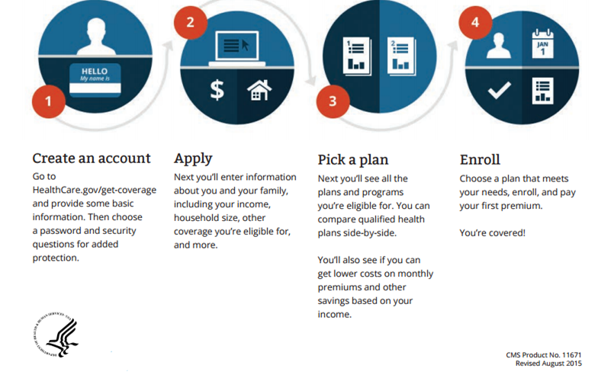
How the Federally-facilitated and State-Partnership Marketplaces Work
May apply or change plan during Special Enrollment Period due to certain qualifying events.
Notes:
There are four steps to using the Federally-facilitated and State-Partnership Marketplaces when enrolling or renewing coverage during open enrollment.
Create an account. First provide some basic information. Then choose a user name, password, and security questions for added protection.
Apply. Next you’ll enter information about you and your family, including your income, tax household size, other coverage you’re eligible for, and more. Visit HealthCare.gov to get a checklist to help you gather the information you’ll need.
Pick a plan. Next you’ll see the plans and programs you’re eligible for and compare them side-by-side. If requested, you’ll also find out if you can get lower costs on monthly premiums and out-of-pocket costs.
Enroll. Choose a plan that meets your needs and enroll.
If you have any questions, there’s plenty of live and online help along the way.
Applying for affordability programs is optional. However, your eligibility information will still be verified against data sources even if you don’t apply for lower premiums.

Slide 27
Premium Payment
You must pay the first month’s premium directly to your insurance company by the insurer’s deadline
You must pay the premium each month or you could lose coverage
Issuers must accept at least these payment methods
Paper check
Cashier’s check
Money order
Electronic fund transfer (EFT)
Pre-paid debit card
Some issuers may also accept online, credit card, or debit card payments (check with the plan)
Notes:
Once you select a plan and enroll, you must pay your first premium directly to the insurance company – not to a Marketplace. You’ll receive a link to the issuer’s payment site, if the issuer provided one. QHP issuers may, but aren’t required to, accept payment online at the time of enrollment. If there is no link, or if you complete plan selection via the Call Center, contact the QHP issuer directly to inquire about other options to make premium payments. You must pay your first month’s premium by the insurer’s deadline to get coverage.
CMS requires issuers to accept a variety of payment methods, including paper checks, money orders, cashier's checks, electronic fund transfers (EFT), and pre-paid debit cards. They don’t have to accept credit card or debit card payments unless states make that a requirement, although many insurers currently accept all of these forms of payment. Therefore, it may vary from state to state and between insurers.
Each insurer sets its own payment deadline. Some insurers may accept your first payment after your coverage has become effective or pay for your care retroactively. Contact your insurer to find out when you need to make your payment and what flexibility they’re able to give you.
If you don’t pay your premiums, your enrollment may be terminated by your issuer. There’s a 3 month grace period for you if you’re receiving an advanced payment of the premium tax credit (APTC), as long as you paid at least 1 full month’s premium. If you’re not receiving APTC, the exact length will vary depending on state law.
You’re free to end your enrollment in a QHP at any time – no Special Enrollment Period is required. To do so, you must terminate your Federally-facilitated Marketplace enrollment through the Marketplace and generally may specify the effective date of termination as long as it’s at least 14 days in advance. However, if you go for 3 months or more without minimum essential coverage and don’t qualify for an exemption, you may have to pay a fee. To terminate enrollment, log into your “MyAccount” on HealthCare.com and navigate to the “My plans & programs” tab. Then select the red button labeled “End (Terminate) All Coverage.” This will terminate coverage for the entire enrollment group. In short, this process will apply if you’re single (enrollment group of 1), or request termination of the entire enrollment group (you and everyone else on your application). If you would like to terminate less than a full enrollment group, your enrollment group must use the “report a life change” functionality.

Slide 28
Marketplace Appeals
If you don’t agree with a decision made by a Health Insurance Marketplace, you may be able to file an appeal.
You can appeal the following kinds of Marketplace decisions
Whether you’re eligible to buy a Marketplace plan
Whether you can enroll in a Marketplace plan outside the regular Open Enrollment Period
Whether you’re eligible for lower costs based on their income
The amount of savings you’re eligible for
Whether you’re eligible for Medicaid or the Children’s Health Insurance Program (CHIP)
Whether you’re eligible for an exemption from the individual responsibility requirement (fee)
Notes:
If you don’t agree with a decision made by a Health Insurance Marketplace, you may be able to file an appeal.
You can appeal the following kinds of Marketplace decisions
Whether you’re eligible to buy a Marketplace plan
Whether you can enroll in a Marketplace plan outside the regular Open Enrollment Period
Whether you’re eligible for lower costs based on your income
The amount of savings you’re eligible for
Whether you’re eligible for Medicaid or the Children’s Health Insurance Program (CHIP)
Whether you’re eligible for an exemption from the individual responsibility requirement (fee)

Slide 29
Enrollment Assistance
Help is available in the Marketplace
Marketplace Call Center
Marketplace-approved in-person help is available
Use the Find Local Help tool at Localhelp.HealthCare.gov/
Language assistance is available through interpreters, Call Center support, and print and web resources
Help is available to complete application
Job aids in 33 languages
Notes:
If you have questions or need help applying for coverage, there are resources, including a toll-free Call Centers and websites with plan comparison tools. There is also Marketplace-approved in-person help is available through several programs to help you with the process of enrolling and using health insurance, including the Navigator program.
Use the Find Local Help tool at LocalHelp.HealthCare.gov to find local, personal help applying for health coverage.
Language assistance is available through interpreters, Call Center support, and print and web resources.
Help is available to complete application in job aids in 33 languages.

Slide 30

Marketplace Call Center
Services consumers in Federally-facilitated
and State-Partnership Marketplaces
1-800-318-2596 (TTY 1-855-889-4325)
Customer service representatives available 24/7
Help with eligibility, enrollment, and referrals
Assistance in English and Spanish
Oral interpretations for 240+ additional languages
State-based Marketplaces have own Call Centers
Notes:
There’s a National Marketplace Call Center for consumers who live in states operating Federally-facilitated and State-Partnership Marketplaces. When you call, you’ll be asked what state you live in. The number for the Marketplace Call Center is 1-800-318-2596. TTY users should call 1-855-889-4325.
Customer service representatives are available 24 hours a day, 7 days a week, including New Year's Day. The Call Center is closed on Memorial Day, the Fourth of July, Labor Day, Thanksgiving, and Christmas.
Customer service representatives can help you complete the entire application and enrollment process from beginning to end with information you provide over the phone, including reviewing your options and helping you enroll in a plan. They can also answer questions as you fill out an online or paper application and refer you to local help resources in your community.
The Call Center provides objective information in English and in Spanish. It also uses a language line to provide assistance for more than 240 additional languages.
NOTE: You may be referred if you live in a state with a State-based Marketplace or SHOP to your state’s Call Center.

Slide 31
Small Business Health Options Program (SHOP) Call Center
For questions about SHOP
1-800-706-7893 (TTY 711)
Customer service representatives available Monday – Friday from 9 a.m. to 7 p.m. ET
Notes:
There’s a Small Business Health Options Program (SHOP) Call Center where you can get your SHOP questions answered by a customer service representative at 1-800-706-7893 or (TTY 711). The Call Center is open Monday through Friday, 9 a.m. to 7 p.m. ET.
If your state has its own SHOP, you will be referred to its SHOP Call Center.

Slide 32
Marketplaces and People with Medicare
Medicare isn’t part of a Marketplace
If you have Medicare, you don’t need to do anything related to the Marketplaces
Your benefits don’t change because of the Marketplaces
It’s illegal to sell you a Marketplace plan
Except an employer through the Small Business Health Options Program (SHOP) if you’re an active worker or dependent of an active worker
The SHOP employer coverage may pay first
No late enrollment penalty if you delay Medicare
Doesn’t include COBRA coverage
Notes:
Medicare isn’t a part of the Health Insurance Marketplaces. Medicare Part A provides minimum essential coverage. If you have Medicare, you don’t have to do anything related to the Marketplaces. The Marketplaces don’t change your Medicare plan choices or your benefits. Medicare plans and supplement (Medigap) policies aren’t available in the Marketplaces.
It’s against the law for someone who knows that you have Medicare to sell or issue you a Marketplaces policy. This is true even if you have only Medicare Part A or only Part B. The exception is coverage from your employer, including through the Small Business Health Options Program.

Slide 33



From Coverage to Care
Written materials available in English, Spanish, Korean, Chinese, Vietnamese, Haitian, Creole, Arabic, and Russian. There is also a Tribal version.
Marketplace.cms.gov/technical-assistance-resources/c2c.html#Resources
Videos in English and Spanish
Notes:
From Coverage to Care is an initiative to help people with new health care coverage understand their benefits and connect to primary care and the preventive services that’re right for them, so they can live a long and healthy life. This information is helpful for you on your journey from coverage to care.
The Enrollment Toolkit can help you learn more about what you need to know before choosing and enrolling in a plan, including information on copayments, deductibles, and financial assistance. Once enrolled, the “Roadmap to Better Care and a Healthier You” provides help on using your insurance, finding a doctor, and receiving primary care and certain preventive services.
Print resources include the full “Roadmap” booklet and the 8 individual steps (and consumer tools) available in 8 languages, the Enrollment Toolkit, and Discussion Guide are available in English, Spanish, Korean, Chinese, Vietnamese, Haitian, Creole, Arabic, and Russian. There is also a Tribal version.
To view the resources, print, download, or order free copies, please go to Marketplace.cms.gov/technical-assistance-resources/c2c.html.
Companion videos are available in English and Spanish and can be accessed at the link above.

Slide 34
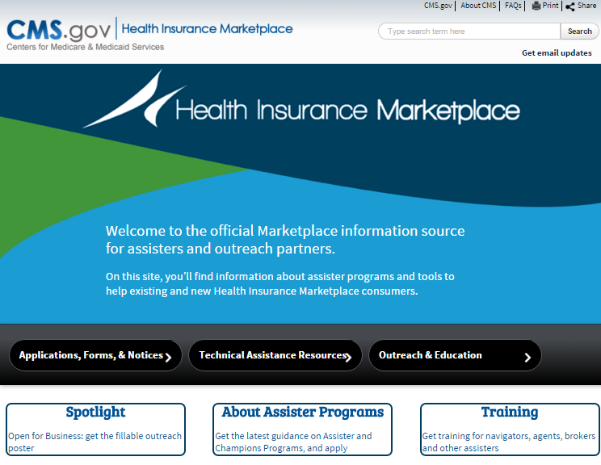
Marketplace.cms.gov
Get the latest resources to help people apply, enroll, and get coverage at Marketplace.cms.gov
Notes:
You can get up-to-date information to help you counsel people about Heath Insurance Marketplaces at Marketplace.cms.gov. There’s access to consumer materials, training materials (including videos), research and more. You can sign up for updates as well. This is also where organizations can apply to become certified application counselors and Champions for Coverage.

Slide 35
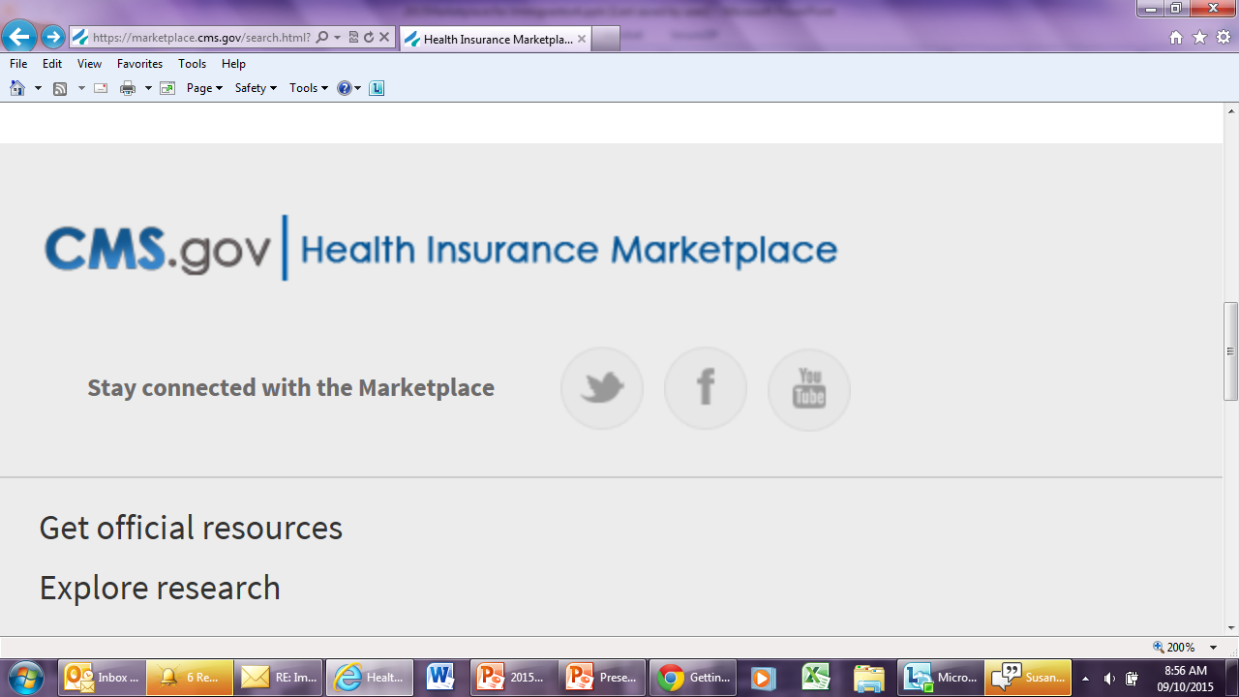
Want More Information about the Marketplace?
Twitter@HealthCareGov
Facebook.com/Healthcare.gov?_rdr=p
YouTube.com/playlist?list=PLaV7m2-zFKpgZDNCz7rZ3Xx7q2cDmpAm7
Sign up to get email and text alerts at HealthCare.gov/subscribe
CuidadoDeSalud.gov for Spanish
Updates and resources for organizations are available at Marketplace.cms.gov
Notes:
Need more information about the Health Insurance Marketplace?
Sign up to get email and text alerts at HealthCare.gov/subscribe/.
CuidadoDeSalud.gov/es/ provides the HealthCare.gov information in Spanish.
Updates and resources for partner and stakeholder organizations are available at Marketplace.cms.gov.
Like us on Facebook and follow us on Twitter!

Slide 36
Key Points to Remember
A Marketplace is a way for qualified individuals and families to find and buy health insurance
You may enroll or change plans during a Special Enrollment Period if you have certain qualifying life events
Eligible small employers can cover their employees through the SHOP
States have flexibility to establish their own Marketplace
Individuals and families may be eligible for lower costs on their monthly premiums and out-of-pocket costs
There is help available
If a you don’t agree with a decision made by a Marketplace, you may be able to file an appeal
Notes:
Here are some key points to remember:
A Marketplace is a way for qualified individuals and families to find and buy health insurance
You may enroll or change plans during a Special Enrollment Period if you have certain qualifying life events. However, you may enroll in Medicaid and CHIP at any time you’re eligible.
Eligible small employers can cover their employees through the SHOP
States have flexibility to establish their own Marketplace
Individuals and families may be eligible for lower costs on their monthly premiums and out-of-pocket costs
There is assistance available to help you get the best coverage for your needs
If you don’t agree with a decision made by a Health Insurance Marketplace, you may be able to file an appeal. Decisions you may appeal include eligibility for a Marketplace, Medicaid, or CHIP coverage, whether you qualify for a Special Enrollment Period, lower costs, or fee exemption. Appeal request forms are available at HealthCare.gov/marketplace-appeals/.

